Slide 1
AuToMaToN
An overview of the DevOps project.

Slide 2
Dharam

Slide 3
Bamboo

Slide 4
Zabbix

Slide 5
Alastair Livingstone

Slide 6
Java Module

Slide 7
Nexus

Slide 8
Alex Mulkerrin

Slide 9
Puppet Master

Slide 10
Jira

Slide 11
Jenkins

Slide 12
Tim Goodwin

Slide 13
Git

Slide 14
MySQL

Slide 15
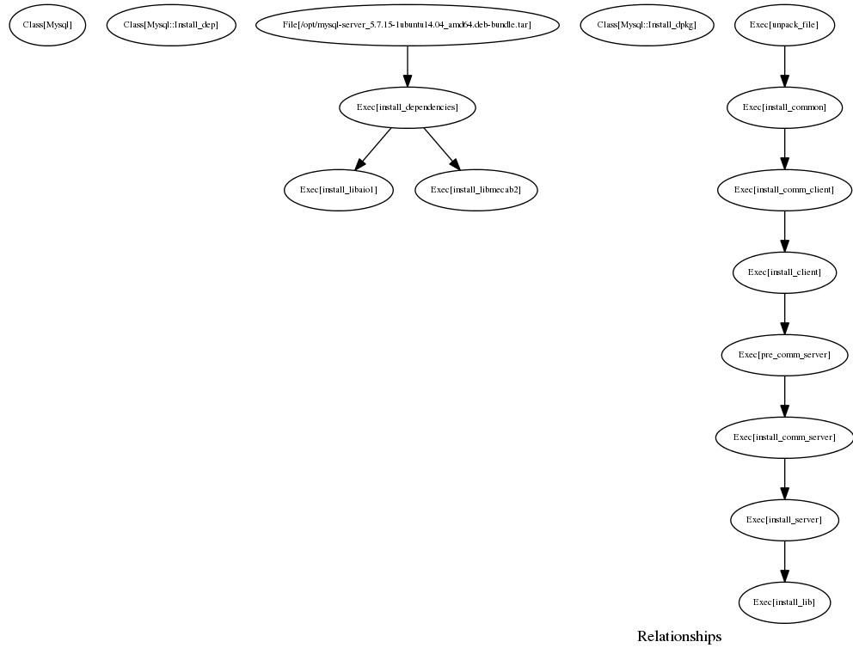

Slide 16
Will - RIP

